Slide 1
DMAS: Decentralized Multiagent Simulation – System Architecture
Alan Aguilar Jaramillo, Ben Gorr, Chrissi Erwin, Dr Daniel Selva Valero

Slide 2
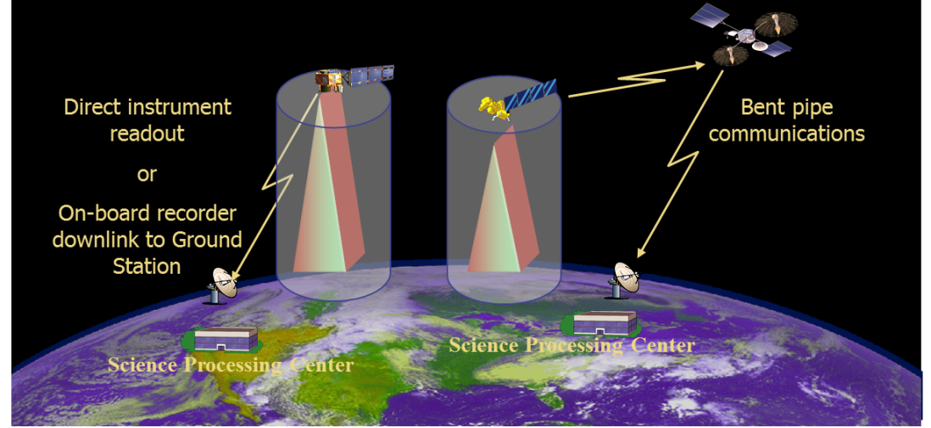
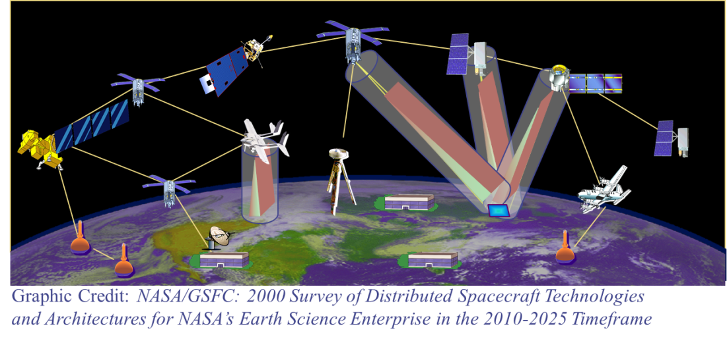
Motivation and Challenges
Space-based Earth observation is undergoing a paradigm change
Easier access to space
More affordable access to space
Higher grade commercial off-the shelf components
Increased computation power
Implementation of Distributed Architectures
Many smaller and heterogeneous satellites, w/ crosslinks
Federations (coordination among assets owned and operated by different organizations)
Onboard measurements processing
Starting to be implemented (e.g., TROPICS [1], CYGNSS [2])
Due to operations logistics, large constellations demand autonomous operations to maximize performance
NASA Sensor Web concept (image credit NASA GSFC)

Slide 3
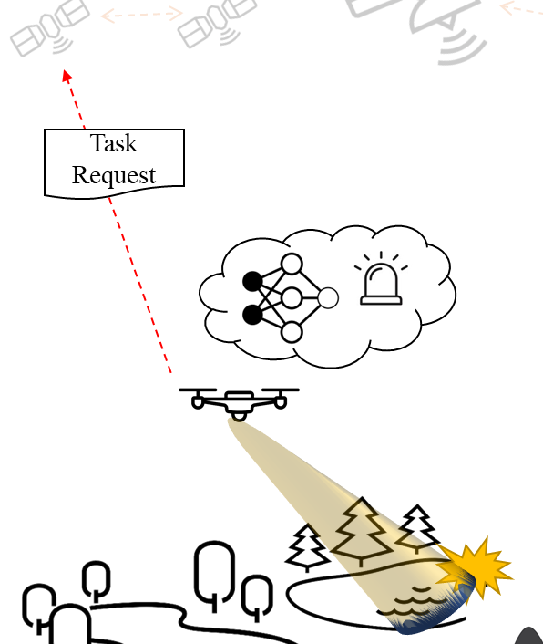
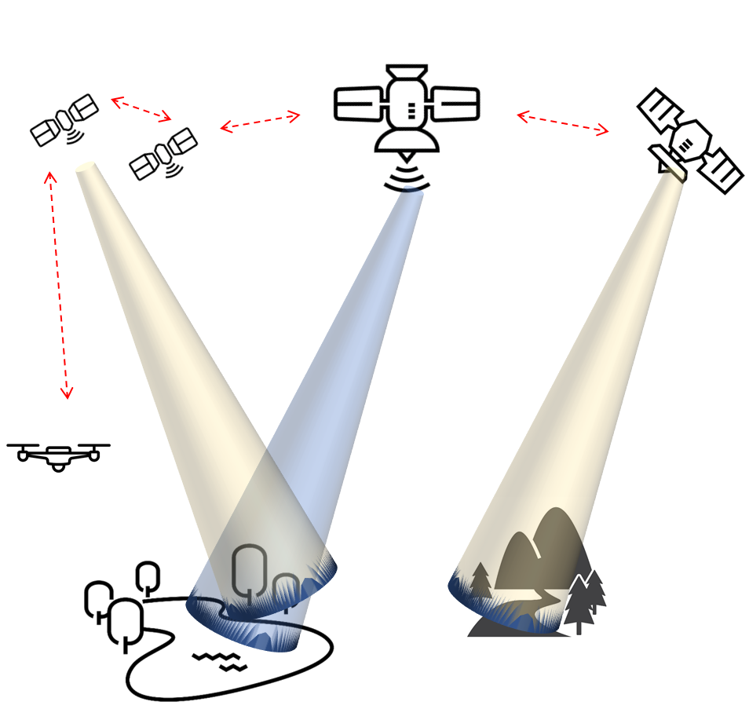
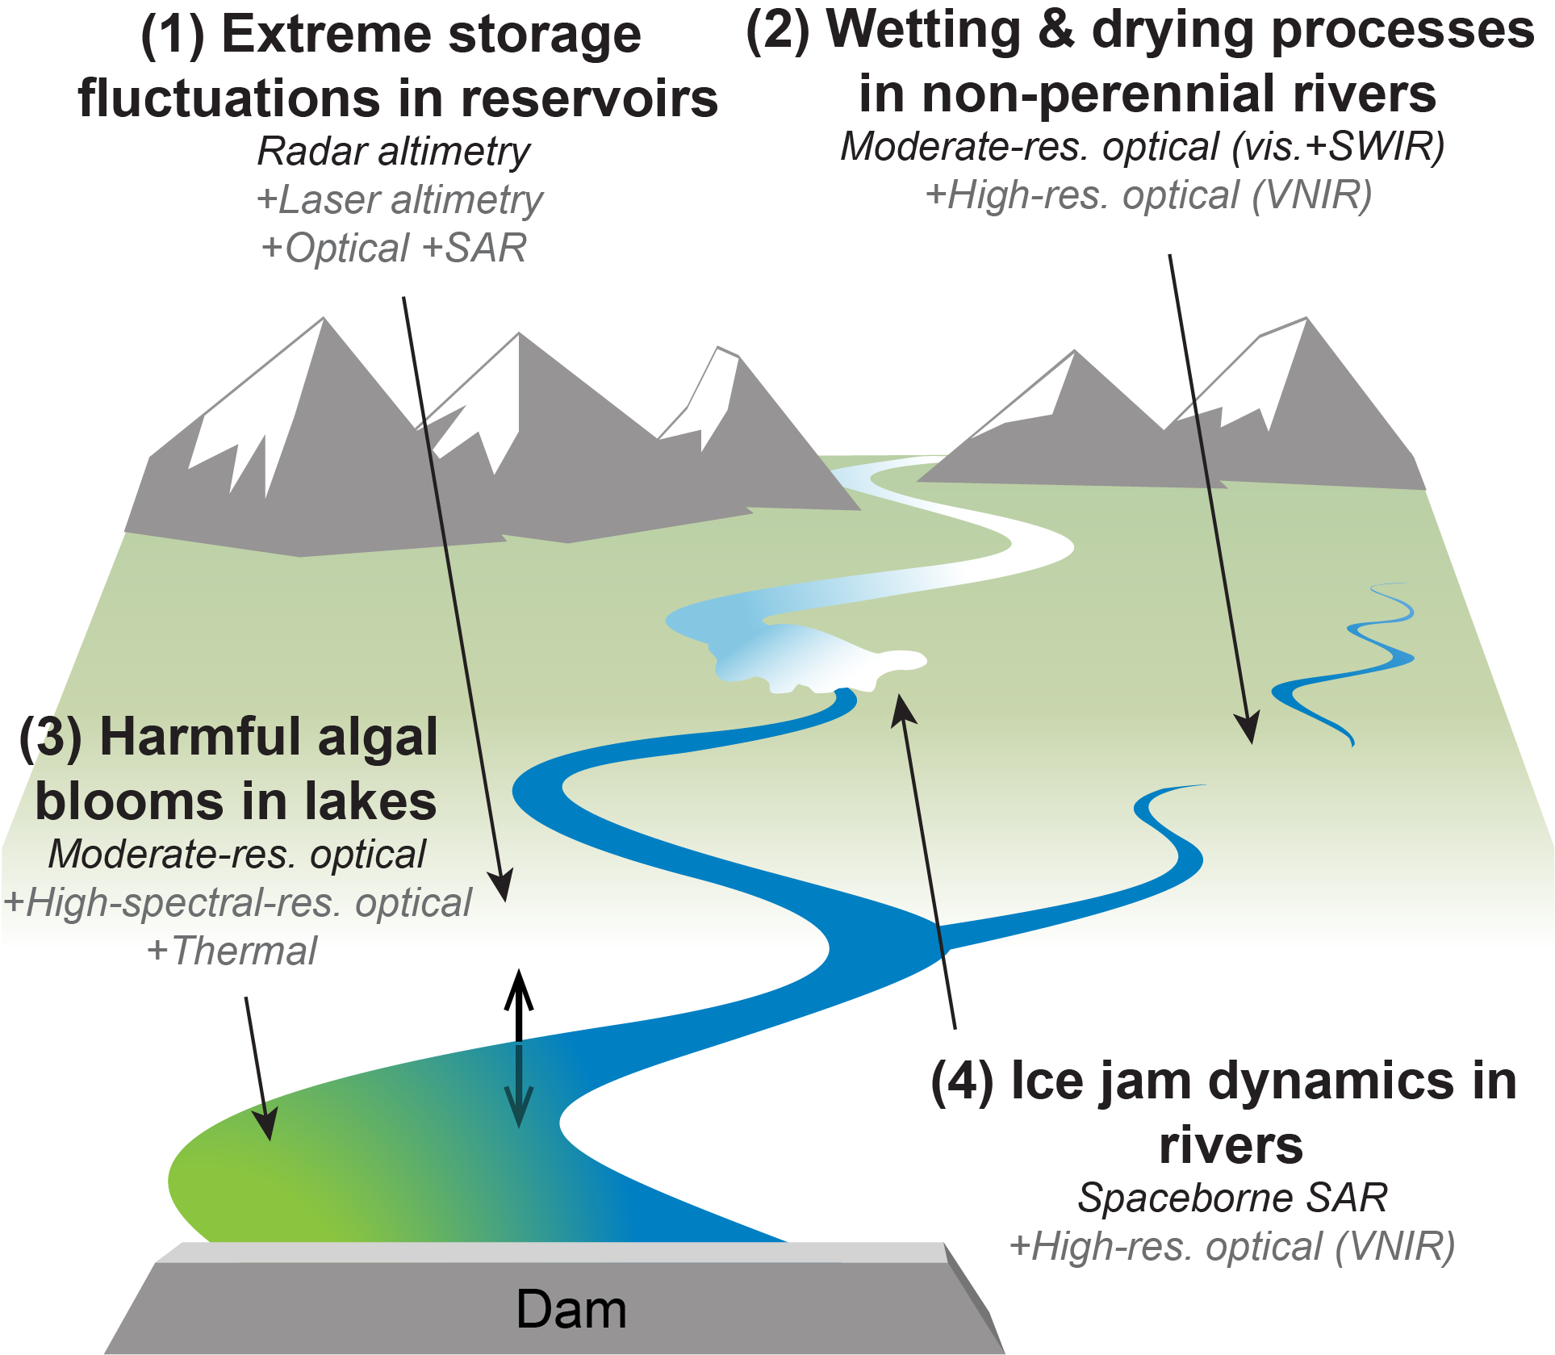
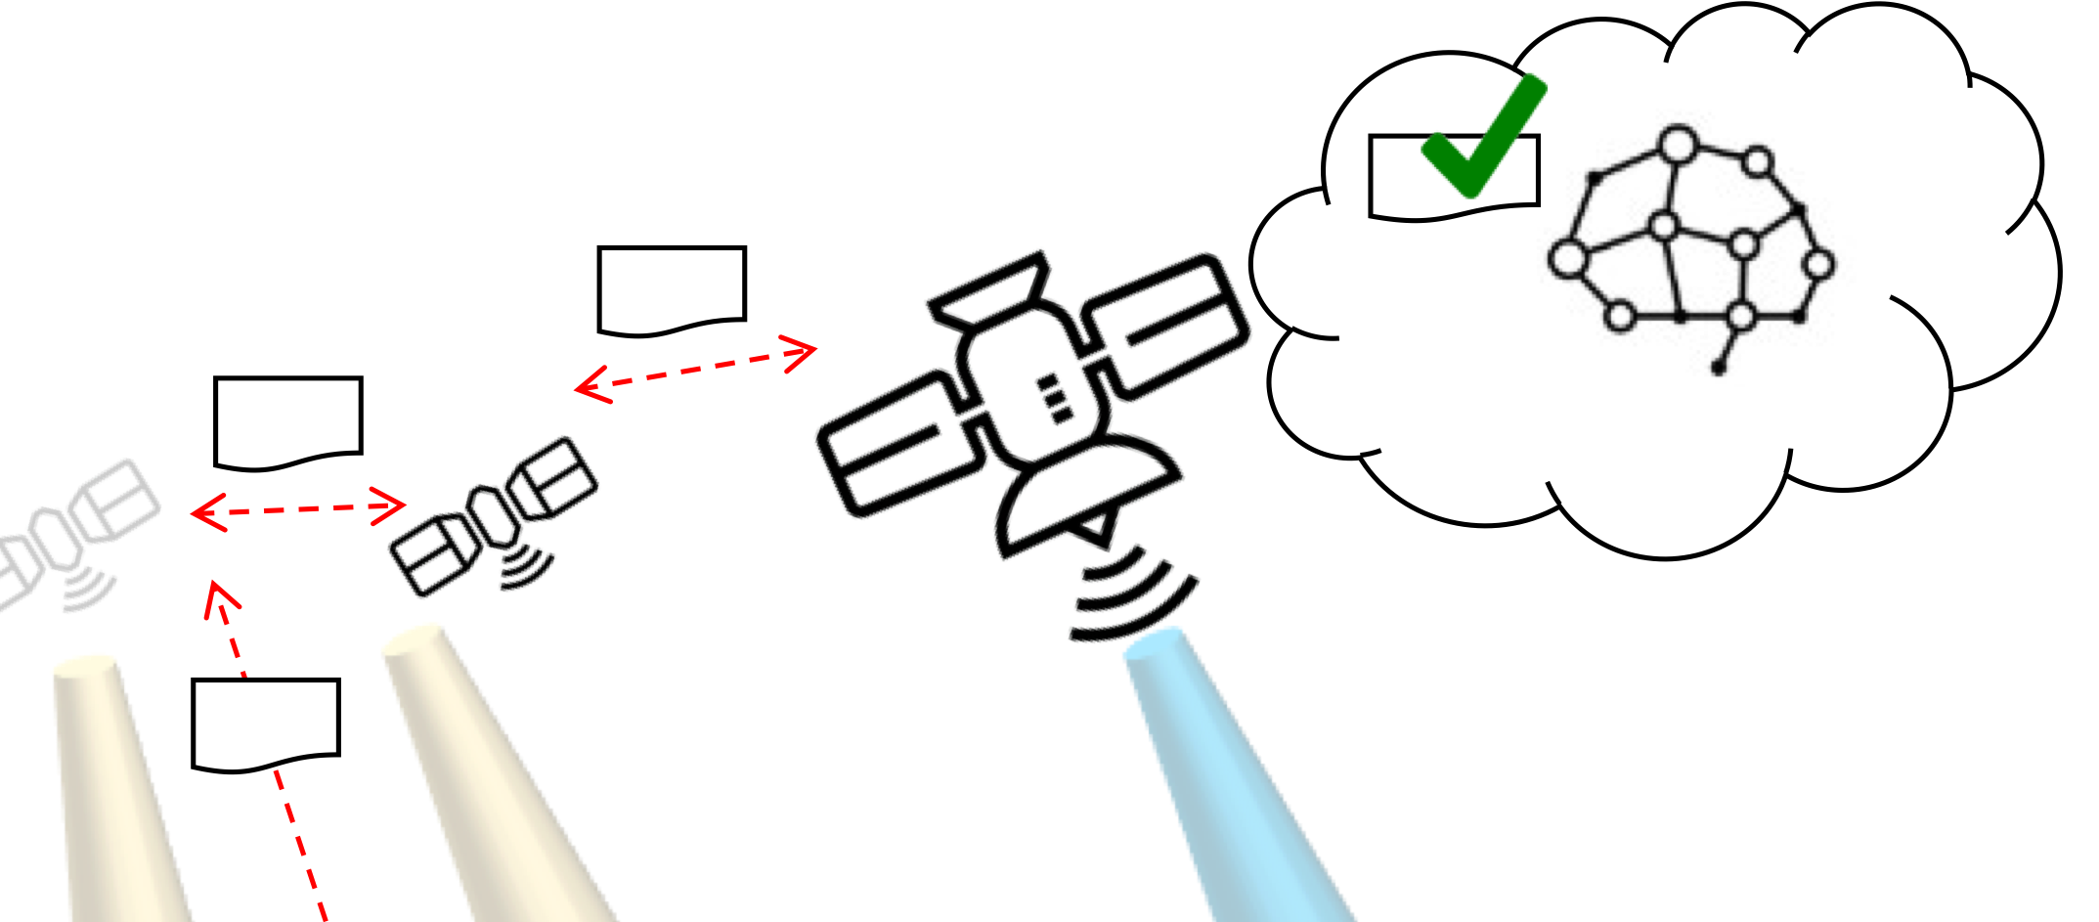
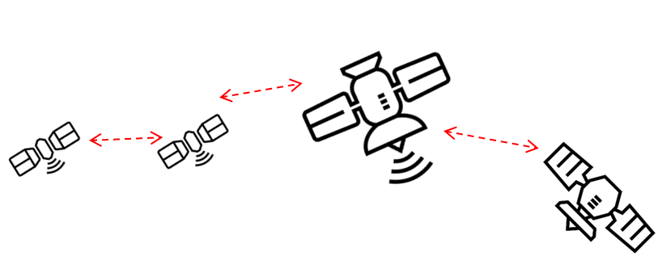
Mission Concept: 3D-CHESS
Goal: provide proof of concept for a context-aware network of heterogeneous sensors, in the context of an inland water ecosystem monitoring mission
1 – Default missions; data processing
2 – Event detected; task request sent
Proposed 3D-CHESS Scenario
3 - Knowledge-based task filtering
4 – Decentralized planning
Proposed 3D-CHESS Concept of Operations
Notes:
To give you an idea of where we are today in terms of actual missions that have flown

Slide 4
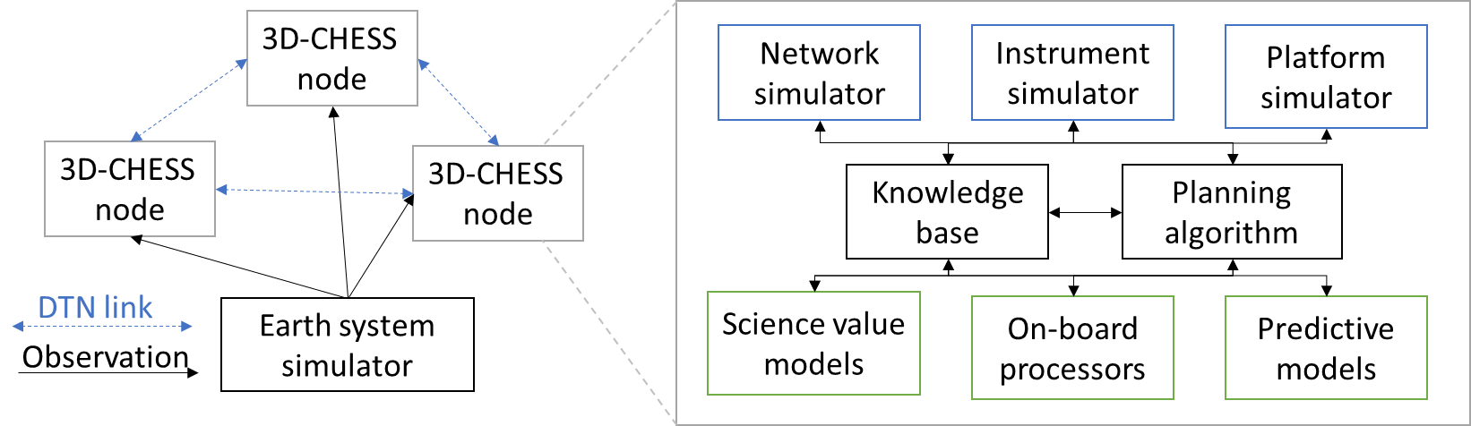
Mission Concept: 3D-CHESS
Goal: provide proof of concept for a context-aware network of heterogeneous sensors, in the context of an inland water ecosystem monitoring mission
Proposed 3D-CHESS Simulation Framework
Proposed 3D-CHESS Scenario
Notes:
To give you an idea of where we are today in terms of actual missions that have flown

Slide 5
Decentralized Multiagent Simulation (DMAS)
Agent 2
Client
Agent to Agent: Task, Requests, Results (broadcasted or targeted)
Agent 1
Client
Agent 3
Client
Agent to Environment: Sense agent state, perform measurement
Environment to all Agents: Broadcasts simulation events
Environment
Server
Proposed 3D-CHESS Simulation Framework
DMAS Simulation Framework

Slide 6
Inter-Agent Messages
Receivers
Broadcast: All nodes in the network
Targeted: Specific node(s) in the network
Action: From one node to itself
Tasks
Actions to be performed by the receiving agent
Is the output of each agent’s scheduling algorithm
Requests
Actions that may be performed by the agent if scheduled
Is the input of the agent’s scheduling algorithm
Data/Information
Contains some kind of information relevant to the receiving agent
i.e., Measurement results, agent state, etc…
Agent 2
Client
Agent to Agent: Task, Requests, Results (broadcasted or targeted)
Agent 1
Client
Agent 3
Client
Agent to Environment: Sense agent state, receives measurement information
Environment to all Agents: Broadcasts simulation events
Environment
Server
DMAS Simulation Framework

Slide 7
Environment Server Architecture
Simulation Control
Initialize network and wait for all agents to synchronize with the server
Generate and publish a ledger of agent port addresses
Broadcast simulation start and end
Broadcast simulation time (optional)
Earth System Simulator
Propagate the state of the world
Create data for instrument to measure
Agent External State Propagator
Agent position, velocity, attitude, and eclipse state
Respond to requests from agents (be sensed by agents)
Broadcast agent-related events
i.e., inform agent that it has entered eclipse, so its solar panels stop producing power regardless of whether the agent sensed the eclipse or not.
Environment
Server
Simulation Control
-Simulation Control Events
-Simulation Clock (optional)
PUB
Agents
Agent External State Propagator
REP
-Agent Events
-GP access req
-GS access req
-Agent access req
-Agent state req
Objective: Make the environment house all “True/Real” values of the simulation and have the agents sense those values through their sensors and instruments.
-Measurement observation metrics req
Earth System Simulator

Slide 8
Agent Simulation Architecture
Agent
Simulation Module
Event Handler
-Simulation Events
Sim Start/End
-Scenario Events
-Simulation Events
SUB
-Scenario Events
Environment
-Measurement Results (from self or other agents)
-Information Request
REQ
Science Module
-GP access info
-GS access info
-Agent access info
-Agent state info
-Measurement observation metrics info
-Measurement Requests
-Information Requests
-Measurement Request (in)
-Information Request (in)
-Measurement Results (in)
-Planner Results (in)
Engineering Module
-Agent State
-Planner Results (in)
-Measurement Requests (in)
Proposed 3D-CHESS Agent Framework
REQ
Scheduler Module
-Scheduled Measurement Measurements
-Measurement Requests (out)
-Planner Results (out)
Other Agents
REP
-Measurement Request (out)
-Information Request (out)
-Measurement Results (out)
-Planner Results (out)
DMAS Agent Framework

Slide 9
Agent Simulation Architecture
Agent
Simulation Module
Event Handler
-Simulation Events
Sim Start/End
-Scenario Events
-Simulation Events
SUB
-Scenario Events
Environment
-Measurement Results (from self or other agents)
-Information Request
REQ
Science Module
-GP access info
-GS access info
-Agent access info
-Agent state info
-Measurement observation metrics info
-Measurement Requests
-Information Requests
-Measurement Request (in)
-Information Request (in)
-Measurement Results (in)
-Planner Results (in)
Engineering Module
-Agent State
-Planner Results (in)
-Measurement Requests (in)
Proposed 3D-CHESS Agent Framework
REQ
Scheduler Module
-Scheduled Measurement Measurements
-Measurement Requests (out)
-Planner Results (out)
Other Agents
REP
-Measurement Request (out)
-Information Request (out)
-Measurement Results (out)
-Planner Results (out)
DMAS Agent Framework

Slide 10
Agent Simulation Architecture
Objective: Simulate the agent’s internal state and provide realistic behavior and capabilities based on its components and operations
Agent
Simulation Module
Event Handler
-Simulation Events
Sim Start/End
Desired Capabilities:
Agent State Tracking
Sense and track agent’s external state (position, velocity, attitude, and eclipse)
Track agent’s internal state (power and data generation, storage, and consumption, component status, etc.)
React to environment events
i.e., turn off solar panels if eclipse event occurs
Scheduler Action Performance and Rejection
Receive and perform instructions from scheduler
Revert actions or even turn off agent if a critical state is reached
i.e., interrupt a measurement if power consumption from instruments exceeds generation
Instrument Simulation
Sense the environment
Provide realistic measurement results to science module
Network Simulator
Send and receive messages from/to other agents
Capture network delays
Due to transmission latency and data-rate
Due to buffer saturation
-Scenario Events
-Simulation Events
SUB
-Scenario Events
Environment
-Measurement Results (from self or other agents)
-Information Request
REQ
Science Module
-GP access info
-GS access info
-Agent access info
-Agent state info
-Measurement observation metrics info
-Measurement Requests
-Information Requests
-Measurement Request (in)
-Information Request (in)
-Measurement Results (in)
-Planner Results (in)
Engineering Module
-Agent State
-Planner Results (in)
-Measurement Requests (in)
REQ
Scheduler Module
-Scheduled Measurement Measurements
-Measurement Requests (out)
-Planner Results (out)
Other Agents
REP
-Measurement Request (out)
-Information Request (out)
-Measurement Results (out)
-Planner Results (out)
DMAS Agent Framework

Slide 11
Engineering Module
Agent
Simulation Maintenance Module
Event Handler
-Simulation Events
Sim Start/End
-Scenario Events
-Simulation Events
SUB
Environment
Engineering Module
-Measurement Results (from self or other agents)
-Information Request
REQ
-Scenario Events
Science Module
-GP access info
-GP measurement observation metrics info
Instruments
-Measurement Request (out)
-Information Request (out)
-Measurement Results (out)
-Planner Results (out)
-Scenario Events
-Agent State
-Measurement Requests
-Information Requests
-Agent access info
-Agent position, vel
-Agent eclipse info
Operations Executor
Platform Emulator
-Scheduled task instructions
Planning Module
REP
-Feasibility of task instructions
-Scheduled Tasks
-Measurement Requests (out)
-Planner Results (out)
-Messages (out)
-Itemized task instructions
Other Agents
Network Emulator
Component Data-base and Predictive Models
REQ
-Agent State
-Planner Results (in)
-Measurement Requests (in)
-Measurement Request (in)
-Information Request (in)
-Measurement Results (in)
-Planner Results (in)
-Messages (in)
-Agent State

Slide 12
Engineering Module
Agent
Simulation Maintenance Module
Event Handler
-Simulation Events
Sim Start/End
-Scenario Events
-Simulation Events
SUB
SOFTWARE
Environment
HARDWARE
Engineering Module
-Measurement Results (from self or other agents)
-Information Request
REQ
-Scenario Events
Science Module
-GP access info
-GP measurement observation metrics info
Instruments
MIDDLEWARE
-Measurement Request (out)
-Information Request (out)
-Measurement Results (out)
-Planner Results (out)
-Scenario Events
-Agent State
-Measurement Requests
-Information Requests
-Agent access info
-Agent position, vel
-Agent eclipse info
Operations Executor
Platform Emulator
-Scheduled task instructions
Planning Module
REP
-Feasibility of task instructions
-Scheduled Tasks
-Measurement Requests (out)
-Planner Results (out)
-Messages (out)
-Itemized task instructions
Other Agents
Network Emulator
Component Data-base and Predictive Models
REQ
-Agent State
-Planner Results (in)
-Measurement Requests (in)
-Measurement Request (in)
-Information Request (in)
-Measurement Results (in)
-Planner Results (in)
-Messages (in)
-Agent State

Slide 13

Engineering Module - Plan Execution
Plan Execution Sequence:
Plan Execution Sequence:
Plan Execution Sequence:
Plan Execution Sequence:
Scheduler Module
“Perform measurement of GP 123 @ t=5 w/ instr1”
Scheduler Module
1- Wait for t = 5
2- Maneuver to observe GP 123 with instr1
3- Turn on instr1
4- Sense GP 123
5- Turn off intr1
Scheduler Module
Scheduler Module
“Waiting for t=5…
Wait complete!
State is nominal, proceed to next instruction”
Operations Executor
Operations Executor
Operations Executor
Operations Executor
“Performing maneuver…
Power insufficient to perform maneuver. Cancelling action and reassessing plan…”
“cancel plan”
Platform Emulator
Platform Emulator
Platform Emulator
Platform Emulator
Receive measurement plan from scheduler
Generate operations plan from measurement plan
Execute Plan
React to Plan Execution Errors

Slide 14
Agent Simulation Architecture
Agent
Simulation Module
Event Handler
-Simulation Events
Sim Start/End
-Scenario Events
-Simulation Events
SUB
-Scenario Events
Environment
-Measurement Results (from self or other agents)
-Information Request
REQ
Science Module
-GP access info
-GS access info
-Agent access info
-Agent state info
-Measurement observation metrics info
-Measurement Requests
-Information Requests
-Measurement Request (in)
-Information Request (in)
-Measurement Results (in)
-Planner Results (in)
Engineering Module
-Agent State
-Planner Results (in)
-Measurement Requests (in)
Proposed 3D-CHESS Agent Framework
REQ
Scheduler Module
-Scheduled Measurement Measurements
-Measurement Requests (out)
-Planner Results (out)
Other Agents
REP
-Measurement Request (out)
-Information Request (out)
-Measurement Results (out)
-Planner Results (out)
DMAS Agent Framework

Slide 15
Agent Simulation Architecture
Agent
Simulation Module
Event Handler
-Simulation Events
Sim Start/End
-Scenario Events
-Simulation Events
SUB
-Scenario Events
Environment
-Measurement Results (from self or other agents)
-Information Request
REQ
Science Module
-GP access info
-GS access info
-Agent access info
-Agent state info
-Measurement observation metrics info
-Measurement Requests
-Information Requests
-Measurement Request (in)
-Information Request (in)
-Measurement Results (in)
-Planner Results (in)
Engineering Module
-Agent State
-Planner Results (in)
-Measurement Requests (in)
Proposed 3D-CHESS Agent Framework
REQ
Scheduler Module
-Scheduled Measurement Measurements
-Measurement Requests (out)
-Planner Results (out)
Other Agents
REP
-Measurement Request (out)
-Information Request (out)
-Measurement Results (out)
-Planner Results (out)
DMAS Agent Framework

Slide 16
Agent Simulation Architecture
Objective: Simulate the agent’s internal state and provide realistic behavior and capabilities based on its components and operations
Agent
Simulation Module
Event Handler
-Simulation Events
Sim Start/End
Desired Capabilities:
On-board Data Processing
Process raw data being sensed by the agent’s instrument
Process raw data sent from other agents who may lack processing capabilities
Create measurement requests for areas of interest
Create a data-base with measurements from parent agent or from other agents
Use data-base to detect areas of interest based on processed data
Use predictive models to infer possible future events in areas of interest
Request missing data as a measurement request or an information request to parent agent or to other agents if results would complete predictive model and if prediction would be worth the effort
Quantify Scientific Value of a Measurement
Use predictive models, data-base, and (or) mission requirements to infer the scientific benefit of a potential measurement being considered by the scheduler
-Scenario Events
-Simulation Events
SUB
-Scenario Events
Environment
-Measurement Results (from self or other agents)
-Information Request
REQ
Science Module
-GP access info
-GS access info
-Agent access info
-Agent state info
-Measurement observation metrics info
-Measurement Requests
-Information Requests
-Measurement Request (in)
-Information Request (in)
-Measurement Results (in)
-Planner Results (in)
Engineering Module
-Agent State
-Planner Results (in)
-Measurement Requests (in)
REQ
Scheduler Module
-Scheduled Measurement Measurements
-Measurement Requests (out)
-Planner Results (out)
Other Agents
REP
-Measurement Request (out)
-Information Request (out)
-Measurement Results (out)
-Planner Results (out)
DMAS Agent Framework

Slide 17
Science Module
Agent
Simulation Module
Science Module
Event Handler
-Simulation Events
Sim Start/End
On-board Processor
-Processed data
Science “reasoning”
-Environment Events
-Simulation Events
SUB
-Model req/results
-Environment Events
Environment
Science data-base
-Past data
Science Predictive Models
-Measurement Results (from self or other agents)
-Information Request
REQ
-Proposed Measurement Requests
-Proposed Information
Requests
-Mission Requirements
-Past measurement data
-Model req/results
-GP access req
-GS access req
-Agent access req
-Agent state req
-Measurement observation metrics req
Science Value Model
-Measurement Requests
-Information Request
-Measurement Request
-Information Request
-Measurement Results
-Planner Results
Engineering Module
REQ
Other Agents
-Agent State
-Planner Results (in)
-Measurement Requests (in)
REP
Scheduler Module
-Measurement Request
-Information Request
-Measurement Results
-Planner Results
-Scheduled Measurement Measurements
-Measurement Requests (out)
-Planner Results (out)

Slide 18
Science Module – Chl example
Agent
Simulation Module
Science Module
Event Handler
-Simulation Events
Sim Start/End
On-board Processor – 2BDA algorithm
-Chl-a product
Science “reasoning” – sees if chlorophyll concentration is above 1 standard deviation
-Environment Events
-Simulation Events
SUB
-Environment Events
Environment
Science data-base – past and current chlorophyll levels
-Past chl-a levels
Science Predictive Models – rainfall? Temperature? Historical?
-Raw multi/hyperspectral images (from self or other agents)
REQ
-Chl-a outliers
-Observation metrics
-Algal bloom likelihood
-GP access req
-GS access req
-Agent access req
-Agent state req
-Measurement observation metrics req
-Mission Requirements
-Past measurement data
-Measurement Requests
-Information Request
-Measurement Results (from self)
Science Value Model
-Measurement Requests
-Information Request
-Measurement Request
-Information Request
-Measurement Results
-Planner Results
Engineering Module
REQ
Other Agents
-Agent State
-Planner Results (in)
-Measurement Requests (in)
REP
Scheduler Module
-Measurement Request
-Information Request
-Measurement Results
-Planner Results
-Scheduled Measurement Measurements
-Measurement Requests (out)
-Planner Results (out)

Slide 19
Agent Simulation Architecture
Agent
Simulation Module
Event Handler
-Simulation Events
Sim Start/End
-Scenario Events
-Simulation Events
SUB
-Scenario Events
Environment
-Measurement Results (from self or other agents)
-Information Request
REQ
Science Module
-GP access info
-GS access info
-Agent access info
-Agent state info
-Measurement observation metrics info
-Measurement Requests
-Information Requests
-Measurement Request (in)
-Information Request (in)
-Measurement Results (in)
-Planner Results (in)
Engineering Module
-Agent State
-Planner Results (in)
-Measurement Requests (in)
Proposed 3D-CHESS Agent Framework
REQ
Scheduler Module
-Scheduled Measurement Measurements
-Measurement Requests (out)
-Planner Results (out)
Other Agents
REP
-Measurement Request (out)
-Information Request (out)
-Measurement Results (out)
-Planner Results (out)
DMAS Agent Framework

Slide 20
Agent Simulation Architecture
Agent
Simulation Module
Event Handler
-Simulation Events
Sim Start/End
-Scenario Events
-Simulation Events
SUB
-Scenario Events
Environment
-Measurement Results (from self or other agents)
-Information Request
REQ
Science Module
-GP access info
-GS access info
-Agent access info
-Agent state info
-Measurement observation metrics info
-Measurement Requests
-Information Requests
-Measurement Request (in)
-Information Request (in)
-Measurement Results (in)
-Planner Results (in)
Engineering Module
-Agent State
-Planner Results (in)
-Measurement Requests (in)
Proposed 3D-CHESS Agent Framework
REQ
Scheduler Module
-Scheduled Measurement Measurements
-Measurement Requests (out)
-Planner Results (out)
Other Agents
REP
-Measurement Request (out)
-Information Request (out)
-Measurement Results (out)
-Planner Results (out)
DMAS Agent Framework

Slide 21
Agent Simulation Architecture
Objective: Schedule measurement requests according to the agent’s measurement capabilities and state
Agent
Simulation Module
Event Handler
-Simulation Events
Sim Start/End
Desired Capabilities:
Consider Agent capabilities
Use Knowledge-Base to inform whether the agent can perform a measurement
Consider agent’s current and future state
Use engineering module for current state
Predict agent state as proposed scheduled actions are being performed
Schedule measurements as to maximize scientific value and minimize cost
Quantify the predicted scientific value of a measurement and schedule accordingly
Contain some sort of cost model that weighs down the value of measurements. Can be tied to the engineering cost of performing measurements
Publish and receive results to and from other agent if scheduling algorithm require collaboration with other agents
-Scenario Events
-Simulation Events
SUB
-Scenario Events
Environment
-Measurement Results (from self or other agents)
-Information Request
REQ
Science Module
-GP access info
-GS access info
-Agent access info
-Agent state info
-Measurement observation metrics info
-Measurement Requests
-Information Requests
-Measurement Request (in)
-Information Request (in)
-Measurement Results (in)
-Planner Results (in)
Engineering Module
-Agent State
-Planner Results (in)
-Measurement Requests (in)
REQ
Scheduler Module
-Scheduled Measurement Measurements
-Measurement Requests (out)
-Planner Results (out)
Other Agents
REP
-Measurement Request (out)
-Information Request (out)
-Measurement Results (out)
-Planner Results (out)
DMAS Agent Framework

Slide 22
Scheduler Module
Agent
Simulation Module
Event Handler
-Simulation Events
Sim Start/End
Science Module
-Environment Events
-Simulation Events
SUB
-Environment Events
Environment
-Measurement Requests (out)
-Information Request
-Measurement Results (from self or other agents)
-Measurement Requests
-Information Requests
REQ
-GP access req
-GS access req
-Agent access req
-Agent state req
-Measurement observation metrics req
Scheduler/Planning Module
Knowledge-Base Instrument Capability Reasoning
-Cost Estimate
Cost Model
(Measurement, Maneuver, Downlink)
-Measurement Request
-Information Request
-Measurement Results
-Planner Results
-Measurement Requests (in)
Engineering Module
-Proposed measurements
-Agent State
-Planner Results
Decentralized Observation Planning (multiagent-level)
REQ
-Predicted Agent States
-Scheduled Measurement Measurements
-Measurement Requests (out)
-Planner Results (out)
-Proposed plan
-Agent state
-Proposed plan
-Agent state
Predictive Models
Other Agents
REP
-Modified plan
-Predicted measurements
-Predicted performance
-Measurement Request
-Information Request
-Measurement Results
-Planner Results
DL/ISL/Maneuver (Ops) Scheduling Algorithm (agent-level)
-Science Score of proposed measurements
Measurement Performance Model

Slide 23
Agent Simulation Architecture
Module
Properties
Queue inbox
Module* parentModule
Array<Module*> submodules
Agent 2
Client
Methods
void internal_message_router()
void internal_message_handler()
void routine()
Agent to Agent: Task requests, Information requests, planner results, measurement results
Agent 1
Client
Agent 3
Client
Agent Client
Environment Server
Agent to Environment: Sense agent state, perform measurement
Environment to all Agents: Broadcasts simulation events
Properties
Port environment_broadcast
Port environment_request
Port agent_request
Port agent_responce
Properties
Port reqservice
Port publisher
Methods
void broadcast_handler()
void request_handler()
Environment
Server
Methods
void broadcast_handler()
void submit_request()
DMAS Simulation Framework

Slide 24
Development Status
Simulation Architecture
Environment Server
Spacecraft agent orbit data propagator (orbitPy)
Agent state request handler
Agent eclipse broadcast
Simulation start/end broadcast
Measurement request handler
Earth simulation module
Agent
Environment broadcast handler
Environment request submitter
State request
Eclipse request
Ground station access request
Ground point access request
Ground point measurement request
Agent-to-agent request handler
Agent-to-agent response handler
Github (private repo for now)
Modules
Engineering Module
Define system architecture
Platform Simulator
Power Tracking
Data Tracking
Shutdown if critical
Network Simulator
Instrument Simulator
Develop tool (instruPy)
Implement tool
Operations Planner
Develop rules
Implement rules
Knowledge-base and Predictive models
Develop rules
Implement Rules
Scheduling Module
Define system architecture
Begin development
Science Module
Define system architecture
Begin development

Slide 25
Questions?

Slide 26
References
WJ, Blackwell, Braun, S, Bennartz, R, et al. An overview of the TROPICS NASA Earth Venture Mission. Q J R Meteorol Soc. 2018; 144 ( Suppl. 1): 16– 26
M. P. Clarizia and C. S. Ruf, "Wind Speed Retrieval Algorithm for the Cyclone Global Navigation Satellite System (CYGNSS) Mission," in IEEE Transactions on Geoscience and Remote Sensing, vol. 54, no. 8, pp. 4419-4432, Aug. 2016, doi: 10.1109/TGRS.2016.2541343.
Marinan, A., Cahoy, K. L., Byrne, J., Cordeiro, T., Decker, Z., Marlow, W., ... & Osaretin, I. (2015). Automated Resource-Constrained Science Planning for the MiRaTA Mission.
W. J. W. J. Wolfe and S. E. S. E. Sorensen, “Three Scheduling Algorithms Applied to the Earth Observing Systems Domain,” Manage. Sci., pp. 148–166, 2000.
Duncan, Eddy, and Kochenderfer, Mykel. “Markov Decision Processes For Multi-Objective Satellite Task Planning”,
Cidoncha, X. G., and Selva, D., “Agent-based simulation framework and consensus algorithm for observing systems withadaptive modularity,”Syst. Eng., Vol. 21, no. 5, 2018, pp. 432–545.
Nag, Sreeja, et al. "Autonomous scheduling of agile spacecraft constellations with delay tolerant networking for reactive imaging." (2019).
H. Wang, X. Li, and Y. Liu, “Summary of intelligent algorithms in planning & amp; scheduling of Earth observation satellite,” in IEEE International Conference on Intelligent Computing and Intelligent Systems, 2010, pp. 480–483.
Kennedy, Andrew K., and Kerri L. Cahoy. "Performance analysis of algorithms for coordination of earth observation by cubesat constellations." Journal of Aerospace Information Systems 14.8 (2017): 451-471.
Li, G. 2020. Online scheduling of distributed Earth observation satellite system under rigid communication constraints. Advances in Space Research. 65 (11), 2475-2496.
Gallud,X.,andSelva,D.,“Agent-basedsimulationframeworkandconsensusalgorithmforobservingsystemswithadaptive modularity,” Syst. Eng., 2018, pp. 432, 454.
S. Nag et al., "D-SHIELD: DISTRIBUTED SPACECRAFT WITH HEURISTIC INTELLIGENCE TO ENABLE LOGISTICAL DECISIONS," IGARSS 2020 - 2020 IEEE International Geoscience and Remote Sensing Symposium, 2020, pp. 3841-3844, doi: 10.1109/IGARSS39084.2020.9323248.

Slide 27
Backup Slides

Slide 28
Decentralized Multiagent Simulation (DMAS)
Environment Server
Simulate State of the Earth
Respond to information requests from Agents
Agent position, velocity, eclipse state
Current agents, ground points, or ground stations being accessed by Agents
Measurement Information
Broadcast Environment Events to all Agents
Simulation Start/End
Agent enters/exits eclipse
Simulation clock (optional)
Agent Client
Track and affect internal state
Power and data usage, generation, and storage
Actuating components on or off
Performing Maneuvers
Charging Batteries
Communicate with other agents
Measurement or Information Task Requests
Measurement or Planner Results
Affect Environment
Communicating maneuvers to Environment
Agent 2
Client
Agent to Agent: Task requests, Information requests, planner results, measurement results
Agent 1
Client
Agent 3
Client
Agent to Environment: Sense agent state, perform measurement
Environment to all Agents: Broadcasts simulation events
Environment
Server
DMAS Simulation Framework

Slide 29
Simulation Framework
Agent
Simulation Maintenance Module
Event Handler
-Simulation Events
Sim Start/End
-Environment Events
-Simulation Events
SUB
-Environment Events
Environment
-Measurement Requests
-Information Request
-Measurement Results (from self or other agents)
REQ
Science Module
Proposed 3D-CHESS Agent Framework
-GP access req
-Agent access req
-Agent position req
-Agent eclipse req
-GP measurement observation metrics req
-Measurement Requests
-Proposed measurements’ estimated Science Benefit
-Proposed measurements
-Proposed measurements’ estimated observation metrics
Nomenclature:
Communications Port
Agent Module/Submodule
Process
Inter-process/module
communication link
Inter-agent
communication link
Process Sequence
SUB
-Measurement Request
-Information Request
-Measurement Results
-Planner Results
Engineering Module
-Agent State
-Planner Results (in)
Module
REP
Science Scheduler
-Scheduled Measurement Measurements
-Planner Results (out)
Sim Start/End
Other Agents
REQ
-Measurement Request
-Information Request
-Measurement Results
-Planner Results
DMAS Agent Framework

Slide 30
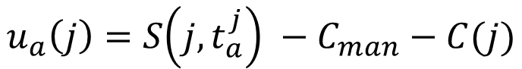



Requirement-Driven Utility Function
$$u_{a}\left(j\right)=S\left(j,t_{a}^{j}\right) −C_{man}−C(j)$$
$$S\left(j, t_{a}^{j}\right)= \frac{S_{max}}{K\left(j\right)} \left(\sum_{i=1}^{n_{req}}{\frac{β_{i}}{1+e^{γ_{i}\left(\frac{X_{{ref}_{i}}−X_{i}\left(j,t_{a}^{j}\right)}{{X_{ref}}_{i}}\right)}}}\right)e^{−λ(t_{a}^{j}−t_{start})}$$
$$s.t.\sum{β_{i}}=1; t_{a}^{j}≥t_{start}$$
Desired Dependencies
Temporal Constraints
Cross-registration with other satellites
Urgency
e.g., short-lived phenomena
Stakeholder Requirement Satisfaction
Spatial Resolution, Measurement Accuracy, etc…
Maneuvering Costs
Measurement Intrinsic Costs
$j$ : Measurement task j
$t_{a}^{j}$ : Time of Measurement of Task j
$S_{max}$ : Maximum Score
$K(j)$ : Level of Completion of Task j
$β_{i}$ : Weight of Requirement i
$γ_{i}$ : Urgency Factor
$X_{ref}$ : Reference performance metric
$X_{i}\left(j,t_{a}^{j}\right)$ : Estimated performance
$λ$ : Urgency Factor
$t_{start}$ : Task start time

Slide 31
Simulation Framework
Agent
Simulation Maintenance Module
Event Handler
-Simulation Events
Sim Start/End
-Environment Events
-Simulation Events
SUB
Environment
Engineering Module
REQ
Network Sim
-GP access req
-Agent access req
-Agent position req
-Agent eclipse req
-GP measurement observation metrics req
send_transmission():
---------------------------------------------------------------
Receive Transmission Request
Await self buffer allocation
Create Routing Plan
Await Access Start
Establish link
Await receiver’s buffer allocation
Start transmission
Await transmission completion
Simulate remaining time Delay
Delete message from buffer
-Measurement Request
-Information Request
-Measurement Results
-Planner Results
REP
Other Agents
receive_transmission():
---------------------------------------------------------------
Await reception request
Await to allocate transmission in buffer
Send allocation confirmation
Await transmission completion
Simulate remaining time delay
Delete message from buffer
Send transmission message to destined module for processing
REQ
-Measurement Request
-Information Request
-Measurement Results
-Planner Results

Slide 32
Simulation Framework
Agent
Simulation Maintenance Module
Event Handler
-Simulation Events
Sim Start/End
-Environment Events
-Simulation Events
SUB
Environment
Engineering Module
REQ
Platform Sim
-GP access req
-Agent access req
-Agent position req
-Agent eclipse req
-GP measurement observation metrics req
periodic_update():
---------------------------------------------------------------
Wait 1 time-step
Update state
Repeat forever
update_state():
---------------------------------------------------------------
dt = current time – previous update time
Update power and data for dt
Check if in eclipse
Check for pos and vel
Update component status
Trigger updated event
Internal_message_handler():
---------------------------------------------------------------
Await message
If message not meant for this module, forward to destination
If environment event, update state
If maintenance action, perform measurement
If measurement action,
If buffer allocation action,
If state request, send latest state
If critical state flag, request actions to operations planner. If no response and still critical, set platform state to false, else do actions and exit process
-Measurement Request
-Information Request
-Measurement Results
-Planner Results
critical_state_timer():
---------------------------------------------------------------
Get current state
If critical, send critical state flag and return
Predict next critical state
Await next critical state or updated event
If updated event, repeat from 1
Else, send critical state flag
perform_measurement():
---------------------------------------------------------------
asd
REP
Other Agents
REQ
-Measurement Request
-Information Request
-Measurement Results
-Planner Results
run():
---------------------------------------------------------------
Wait for all to end: internal_message_handler(), critical_state_timer()

Slide 33
ToDo’s
Engineering Model Integration
Alan: Power and Data Tracking Model
Ben: Attitude Model
Science Value Module
Ben: Spatial Res + Look Angle-based Chlorophyll + TSS
Federated Systems
Define federation in simpy
Use Case
Define federation in simpy

Slide 34
Types of Requests
Past Information Request
“I want soil moisture at (X,Y), does anyone know about this?”
“I am measuring SM at (X,Y) in 5 mins but need temperature measurements, does anyone know about this recently?”
“I an optical measurement from (X,Y), can you tell me if there is Algae here?”
New/Future Measurement Request
“Can someone measure SM at (X,Y) and tell me what the value is?”
Force Measurement Request
“You are measuring SM at (X,Y) because we told you to.”
Publish and subscribe protocol?
Sat X performs periodic measurements and list of Sats X_i receive the periodical data
Request protocol?
Only request the information you need

Slide 35
End Users
Initial Focus: Data collection of the network
Later Focus: Data downlink and information quality
Use case-specific metrics
i.e., How many times were algae blooms detected in single sat mission vs distributed mission
Evaluated information is obtained from GS performing information requests

Slide 36
Validation
Value of context-awareness
Fixed plan vs reactive plan
Importance of different information
No state info, no information requests

